Slide 1
BCOG 100
Lecture 2.1: Empiricism vs. Rationalism

Slide 2
Reading Check 2-2
Code: reason
In what way did Aristotle invent the computer?

Slide 3
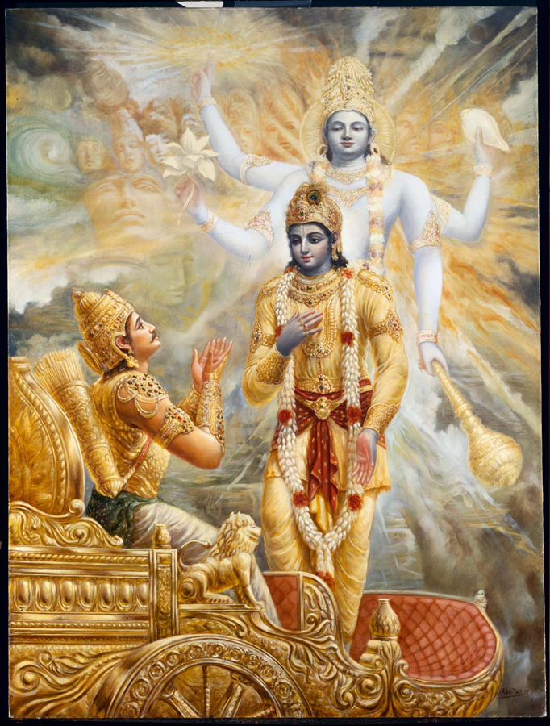
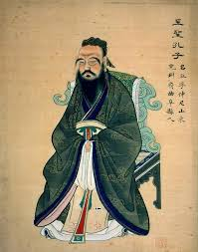

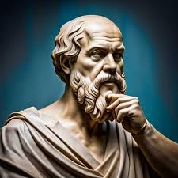
5th and 4th Centuries BC
Confucius
Buddha
Socrates, Plato, & Aristotle
Bhagavad Gita & the Jnana Yoga
Notes:
Confucius linked knowledge with moral virtue, arguing that ignorance often leads to poor judgment and unethical behavior.
believed that not all knowledge is equally important. Moral knowledge—understanding what is right and just—was the highest form of knowledge.
championed education as a way to bridge social divisions and promote harmony.
often highlighted the limitations of one’s own understanding and the need for an open mind
The Buddha emphasized that ignorance (avidya) is the root of all suffering and that true knowledge (prajna) leads to liberation (nirvana).
Practical Knowledge over Abstract Ideas: For the Buddha, knowledge was not merely theoretical but experiential.
Education for Liberation
Limitations of Conventional Knowledge
The Bhagavad Gita links knowledge (jnana) with understanding one’s dharma (moral duty). Jnana Yoga emphasizes self-awareness and discernment as essential for virtue
Higher and Lower Knowledge: The Gita distinguishes between mundane knowledge (apara vidya) and spiritual wisdom (para vidya), with the latter leading to liberation.
Pathways for All: The Gita synthesizes various paths—knowledge (jnana yoga), action (karma yoga), and devotion (bhakti yoga)—making spiritual wisdom accessible to people with different temperaments.
Self-Inquiry and Awareness: Jnana Yoga promotes self-inquiry (Who am I?) to transcend ignorance and realize the unity of the self (Atman) with ultimate reality (Brahman).
Knowledge as the Foundation of Virtue: Socrates argued that knowledge and virtue are inseparable, famously stating, "An unexamined life is not worth living."
Ignorance was seen as the source of moral failings.
Hierarchy of Knowledge: Plato distinguished between opinion (doxa) and true knowledge (episteme), emphasizing the latter as the understanding of eternal truths, such as those found in his Theory of Forms.
Education for Society: Plato advocated for education as a means to cultivate philosopher-kings, individuals who possess wisdom and moral integrity to lead society justly.
Recognizing One’s Ignorance: Socrates emphasized the importance of intellectual humility, encapsulated in his claim, "I know that I know nothing." Aristotle further refined this with his empirical approach, seeking knowledge through observation and reasoning.

Slide 4
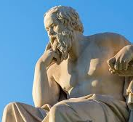
What Is Philosophy? Why Does It Matter for Cognitive Science?
Philosophy: The study of fundamental questions about reality, knowledge, and values—asking what exists, how we know, and what matters.
Value for Cognitive Science:
Clarifies concepts (e.g., mind, knowledge, representation, truth).
Frames foundational debates (empiricism vs. rationalism, mind-body problem).
Provides tools for reasoning (logic, argument analysis).
Pushes us to ask not just “how” but also “why.”

Slide 5
What Is Philosophy? Why Does It Matter for Cognitive Science?
Metaphysics: The study of reality and what kinds of things exist (e.g., minds, bodies, free will).
Epistemology: The study of knowledge—its sources, justification, and limits.
Ethics & Aesthetics: The study of value—what is good, right, or beautiful, and why it matters.
Logic: The study of valid reasoning and argument structure.

Slide 6
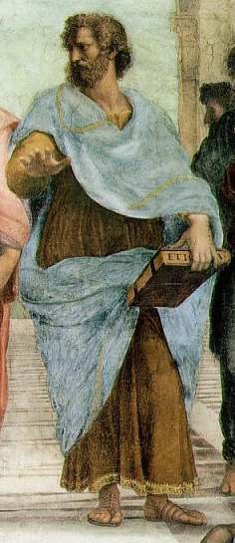
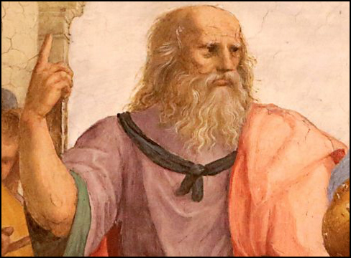
The Two Thousand Year Debate
Rationalism
knowledge derives from a foundation of innate ideas or intuitions, plus additional knowledge that can be derived logically from those foundations
deductive reasoning
Empiricism
knowledge derives from experience
Inductive reasoning

Slide 7
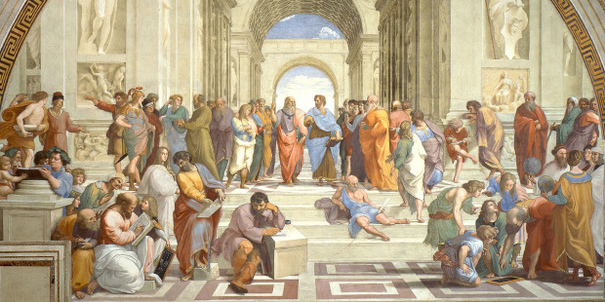
The Two Thousand Year Debate

Slide 8
Plato
Plato (c. 427–347 BCE) — Student of Socrates, teacher of Aristotle.
Innate Knowledge: Believed the soul possesses knowledge prior to experience (doctrine of recollection). Learning = remembering eternal truths.
Reason over Experience: Sensory perception is unreliable; only rational thought gives true knowledge.
Forms and Universals: True reality consists of abstract, unchanging Forms (e.g., “triangle” itself), accessible through reason, not the senses.
Influence on Cognitive Science: Sets up the rationalist intuition that some concepts/structures (e.g., logic, math, grammar) are “built in,” not learned from the environment.

Slide 9
Plato
The Meno
Main Question: “Can virtue be taught?”
Meno’s Paradox: If you already know something there is no need for inquiry. If you don’t already know something, there is no way for inquiry to begin.
Conclusion: Virtue cannot be taught. In fact, nothing can. We can only know what we already know, and therefore everything we know is innate.
Demonstration of “Recollecting” Geometry

Slide 10
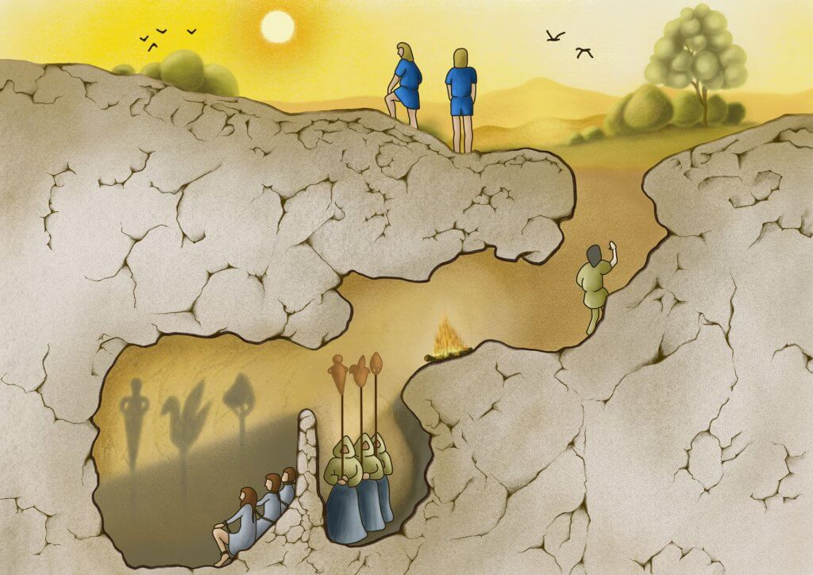
Plato’s Cave Allegory
Plato
Notes:
Allegory: Prisoners in a cave see shadows on the wall, mistaking them for reality.
Escape: One prisoner is freed, sees the real objects and the sun—the Form of the Good.
Symbolism: Critique of ignorance vs. enlightenment; the difficulty of attaining true knowledge.
Implication: Philosophers must ascend to knowledge of the Forms, then return to guide others.

Slide 11
Aristotle
Aristotle: 384-322 BCE
Knowledge from Experience: Rejected Plato’s innate Forms; insisted that knowledge begins with sensory perception.
Induction & Observation: Emphasized collecting observations, classifying, and generalizing—proto-scientific method.
Form in the World: Believed universals exist in things, not apart from them. We abstract them by engaging with the world.
Influence on Cognitive Science: Seeds the empiricist view that the mind starts as a “blank slate” (tabula rasa), shaped by learning and experience.

Slide 12
Aristotle
Aristotle’s Criticism of Deduction
One of the first to point out a problem with a purely deductive approach.
1. A men are mortal
2. Socrates is a man
3. Therefore Socrates is mortal
All X’s are F
x is an X
Therefore x is F
Where do the premises come from? Regress problem.

Slide 13
Aristotle
Aristotle’s Method: Observing the Natural World
Emphasis on systematic observation and classification
Collected data on rocks, animals, plants, constitutions of city-states
Emphasized inductive reasoning: from specific cases → general principles
Example: biological species as universal “kinds” of things. All animals grow, all mammals produce milk, all lions are carnivores.

Slide 14
Aristotle
The Four Causes
Material Cause: what something is made of
Formal Cause: shape, structure, or essence
Efficient Cause: the agent or process that produces the thing
Final Cause: the purpose or function (telos)
Notes:
The Four Causes allowed Aristotle to structure his investigations systematically, ensuring that he accounted for all aspects of an object or phenomenon.
This framework provided the link between empirical observation and philosophical explanation, bridging the gap between science and philosophy.

Slide 15
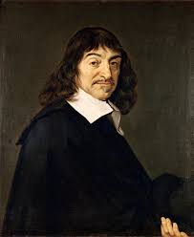
Early Modern Debate
René Descartes (1596–1650):
Rationalist: Advocated certainty through reason, not senses (“Cogito, ergo sum”).
Dualism: Mind and body are distinct substances; the mind is immaterial, the body mechanical.
Innate Ideas: Believed some concepts (e.g., God, mathematics) are built into the mind.
Legacy for CogSci: Introduces the problem of how mental and physical interact—still central to mind-body debates.

Slide 16
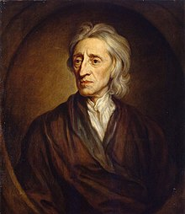
Early Modern Debate
John Locke (1632–1704)
Empiricist: Mind as a “tabula rasa” (blank slate) at birth.
All knowledge from experience: Simple ideas from sensation combine into complex ideas.
Emphasis on learning: Experience and reflection build our concepts of the world.
Legacy for CogSci: Proto-learning theory; foundation for later behaviorism and associationism.

Slide 17
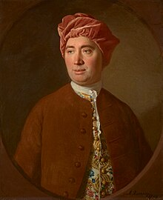
Early Modern Debate
David Hume (1711-1776)
Radical Empiricist/Skeptic: Pushed Locke’s empiricism to its limits.
Problem of Induction: Past experiences don’t logically guarantee the future (we expect patterns out of habit, not reason).
Concept of Causation: Causality is a mental habit, not directly observed.
Legacy for CogSci: Highlights limits of empirical learning and foreshadows modern debates about inference, prediction, and causality.

Slide 18
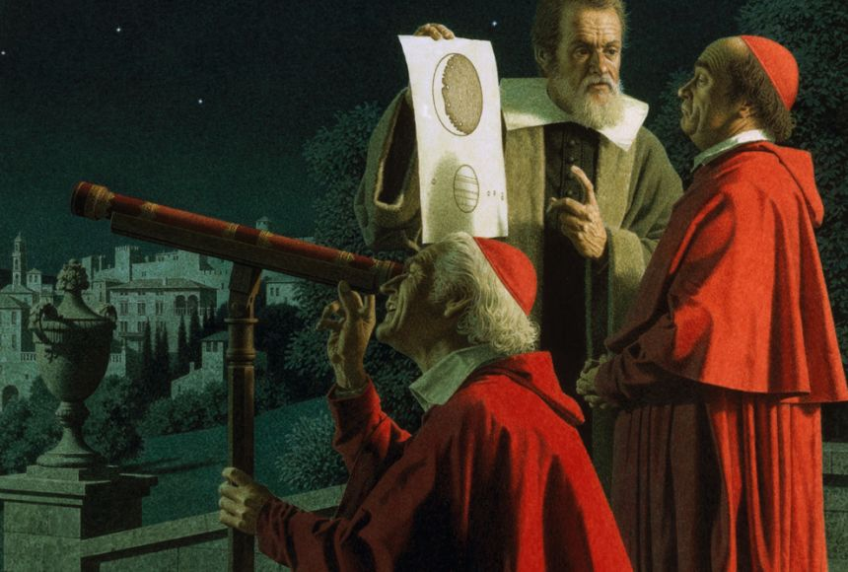
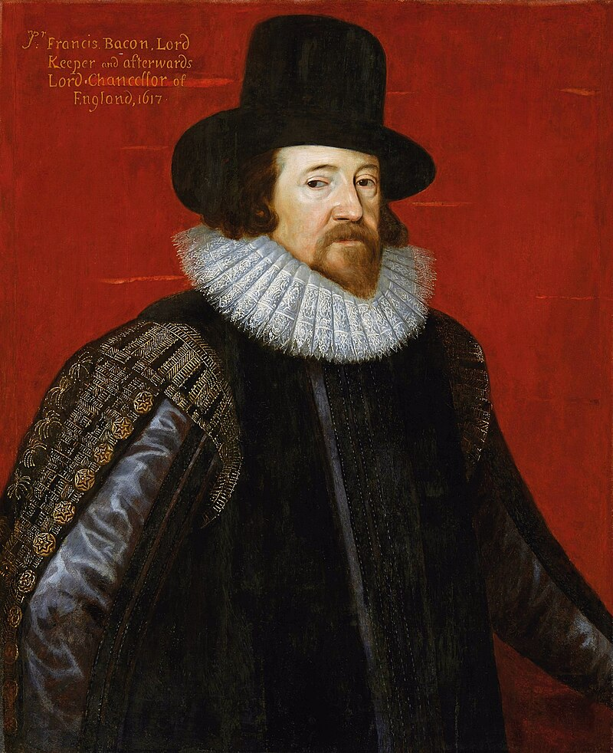
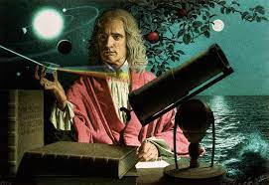
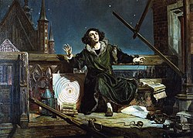
Early Modern Debate
Aristotle’s empirical methods spread widely
Throughout the Greek World, and then the Roman World, then the Arab World
Galileo’s Physics
Francis Bacon’s Scientific Method
Isaac Newton’s Principia Mathematica
Copernicus’s Heliocentric Model

Slide 19
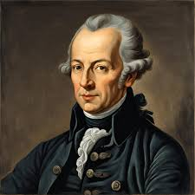
Early Modern Debate
Immanuel Kant (1724–1804): The Great Synthesizer
Synthesis of Rationalism & Empiricism: Experience provides content, but the mind contributes a priori structures (e.g., space, time, causality).
The “Copernican Revolution” in philosophy: We don’t just conform to the world; the world conforms to our ways of organizing it.
Emphasis on Science: Tried to reconcile philosophy with Newtonian physics.
Legacy for CogSci: Anticipates modern ideas that cognition depends on built-in representational frameworks.

Slide 20
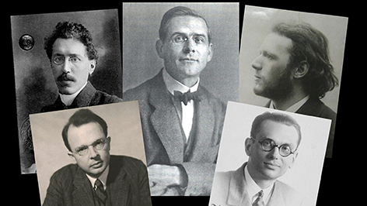
Modern Debate
Logical Positivism & Logical Empiricism
Verification Principle: Only statements verifiable by observation or logic are meaningful.
Anti-Metaphysics: Rejected speculation about unobservable entities.
Science as Language: Philosophy should clarify scientific discourse, not invent theories.
Legacy for CogSci: Shaped early psychology’s emphasis on observable behavior and measurable data.

Slide 21
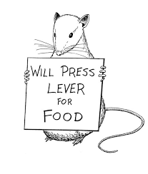
Modern Debate
Behaviorism (1913–1960s)
Psychology without the Mind: Study behavior, not unobservable mental states.
Learning as Conditioning: Pavlov (classical), Skinner (operant).
Radical Empiricism: Environment + reinforcement histories fully eLegacy for CogScixplain behavior.
: Pushed scientific rigor, but left no room for internal representations or reasoning.

Slide 22
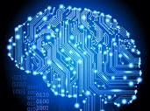
Modern Debate
The Cognitive Revolution (1950s–1960s)
Reaction to Behaviorism: Need to explain internal processes, not just behavior.
Information Processing Metaphor: Mind as a computer; emphasis on representation, algorithms, memory structures.
Interdisciplinary Roots: Linguistics (Chomsky), AI, neuroscience, philosophy.
Swing Towards Rationalism: Internal reasoning and innate knowledge return as parts of explanation
Legacy for CogSci: Established cognitive science as a field—bringing back questions of knowledge, representation, and innate structures.

Slide 23
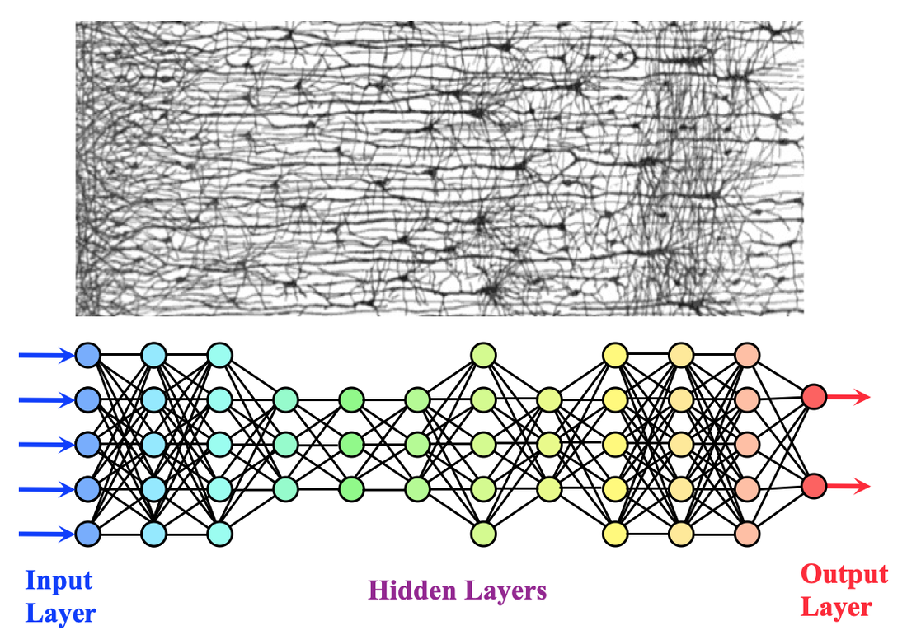
Modern Debate
Connectionism & Machine Learning (1980s–Present)
Return to Learning: Revives empiricist themes through distributed representations and adaptive networks.
Connectionism: Neural networks (Rumelhart & McClelland, 1980s) model cognition via many simple units adjusting their weights.
Machine Learning & Deep Learning: Modern expansion—algorithms learn patterns from massive data without explicit rules.
Contrast with Classical AI: Symbolic AI (rationalist flavor) vs. Connectionist AI (empiricist flavor).
Legacy for CogSci: Offers powerful models of perception, language, and memory; reopens empiricism vs. rationalism debates at a computational scale.

Slide 24
Modern Debate
The Enduring Debate in Cognitive Science
Are ideas and structures innate (rationalism) or learned (empiricism)?
How do we get from perception to knowledge?
Do we need to posit mental representations to explain cognition?
Can experience alone explain human intelligence?

